Slide 1


Abstra
Lazar Milicevic
Weekly support report
Support, Challenges, Sollutions
18.03.2025

Slide 2
Agenda
1. Zendesk Support & Performance Update
3. Surveysparrow Widget Implementation
5. Next Steps & Focus Areas
2. Owkin K Documentation Progress
4. Challenges & Solutions
6. Q&A

Slide 3

Zendesk Support & Performance Update
Customer success: Weekly Support Report – 18.03.2025
What was done:
✅ Rotated Active Agents – Weekly squad rotation completed.
✅ AWS Zendesk Ticket Monitoring – Ongoing oversight of AWS-related tickets.
✅ Handled User Account Updates –
Yacine’s account converted to staff and added to the dataops group.
Romain’s account created and assigned an agent license.
✅ Zendesk Forms & Customization
Request for Developer Tool Form – Removed unnecessary fields using JavaScript.
Dataset Creation Form – Enabled multiselect dropdown logic.
IT and Cloud Request Form – Fixed form loading issues.
✅ Improved Response Time – Average first response time: 8 minutes (3x faster than February).
✅ Expanded L2 Ticket Handling – Handling IP/domain whitelisting independently in collaboration with SRE.
🚀 Focus: Continuous automation & faster support response times.

Slide 4
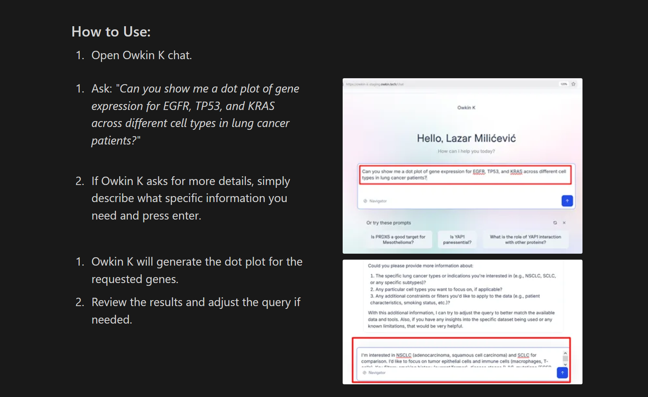
Owkin K Documentation Progress
Customer success: Weekly Support Report – 18.03.2025
Where we are now ?
📌 Ongoing Work on Owkin K Platform Documentation:
✅ Developed a structured plan for the Owkin K Platform User Guide.
✅ Created the first draft of the User Guide.
✅ Conducted detailed issue analysis and documented findings.
✅ Prioritizing documentation improvements to enhance user experience and reduce support tickets.
📄 Relevant Documents:
Owkin K User Guide Structure V1
User Guide Draft
Slack Problem Analysis
🚀 Focus: Completing Owkin K documentation before internal launch.

Slide 5
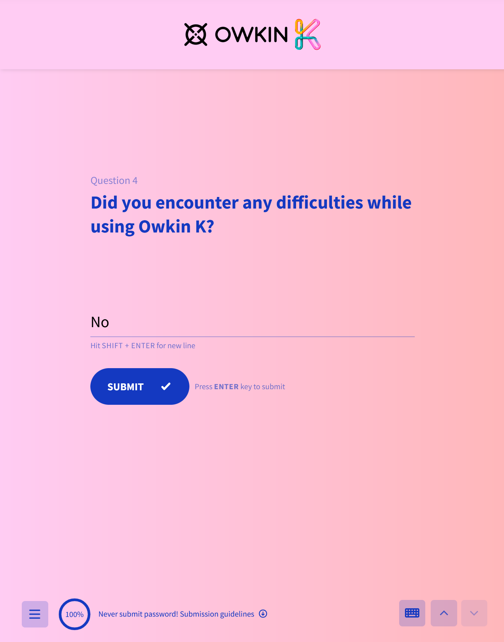
Surveysparrow Widget Implementation
Customer success: Weekly Support Report – 18.03.2025
Where we are now ?
✅ Widget Designed – Aligned with Owkin K branding.
✅ Jeremy’s Access Provided – Review of platform features completed.
✅ Identified Issue – The Surveysparrow widget lacked a sliding animation.
✅ Customized Widget Code – Implemented sliding functionality.
✅ Scheduled Meeting – Discussion with Surveysparrow team today.
🚀 Next Steps: Follow up with Jeremy

Slide 6
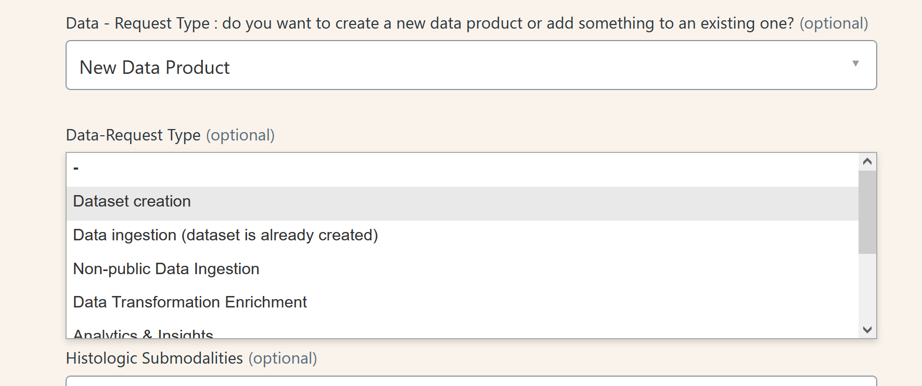
Challenges & Solutions
Customer success: Weekly Support Report – 18.03.2025
Some of them:
🔹 Challenge: Zendesk lack of native support for multi-select fields.
✅ Solution: Implemented custom JavaScript to enable conditional multiselect visibility.
🔹 Challenge: Request for Developer Tool Form contained unnecessary fields (Description & Subject).
✅ Solution: JavaScript code was applied to dynamically hide these fields for a cleaner user experience.
🔹 Challenge: Dataset Creation Form – Limited ability to apply real-time filtering on selections.
✅ Solution: Script enhancements enabled real-time updates based on user selections.
🔹 Challenge: IT and Cloud Request Form failed to load correctly via direct link access.
✅ Solution: Debugged and fixed form loading behavior by modifying Zendesk's unique ID handling.
🔹 Challenge: Surveysparrow widget missing expected sliding animation.
✅ Solution: Modified JavaScript and CSS to add a custom sliding effect for a better UI/UX.
🚀 Continuous Focus: Improving automation efficiency, reducing manual interventions, and enhancing Zendesk workflow usability.

Slide 7

Next Steps & Focus Areas
Customer success: Weekly Support Report – 18.03.2025
What will be done:
Slide 7: Next Steps & Focus Areas
📌 Zendesk
✅ Finalizing Dataset Creation Form (300+ fields, nearing completion).
✅ Increasing Level 2 ticket responsibility (expanding beyond IP whitelisting).
📌 Owkin K Documentation
✅ Completing User Guide before Owkin K’s internal launch.
✅ Implementing structured support strategy for end-users.
📌 Surveysparrow Widget
✅ Final testing and deployment of custom animations for better UI/UX.
🚀 Focus: Expanding technical responsibilities and improving automation efficiency.

Slide 8

Q&A
Customer success: Weekly Support Report – 25.02.2025
?
🔹 Where will the Owkin K documentation be hosted?
Do we have a dedicated tool or platform for hosting this documentation?
Will we use Zendesk Guide or another knowledge base solution?
🔹 LLM API Requests – How can I assist?
Could I get the necessary permissions and access rights to start working on this?

Slide 9
Thank you!

